Slide 1
MOVIE DATA ANALYSIS
viNAY Kumar GUdi

Slide 2
Imported DataFrame from SQL DataBase:
MovieName | Rating | Genre | Runtime | Stars
0 | Stranger Things | 9.0 | Horror| Thriller | 3.931826 | Stars:Millie Bobby Brown| Finn Wolfhard| Winon...
1 | Child's Play | 6.0 | Horror| Thriller | 4.499810 | Director:Lars Klevberg| Stars:Aubrey Plaza...
2 | Annabelle Comes Home | 6.0 | Horror| Thriller | 4.663439 | Director:Gary Dauberman| Stars:Vera Farmig...
3 | Midsommar | 8.0 | Horror| Thriller | 4.990433 | Director:Ari Aster| Stars:Florence Pugh| J...
4 | Brightburn | 6.0 | Horror| Thriller | 4.499810 | Director:David Yarovesky| Stars:Elizabeth ...

Slide 3
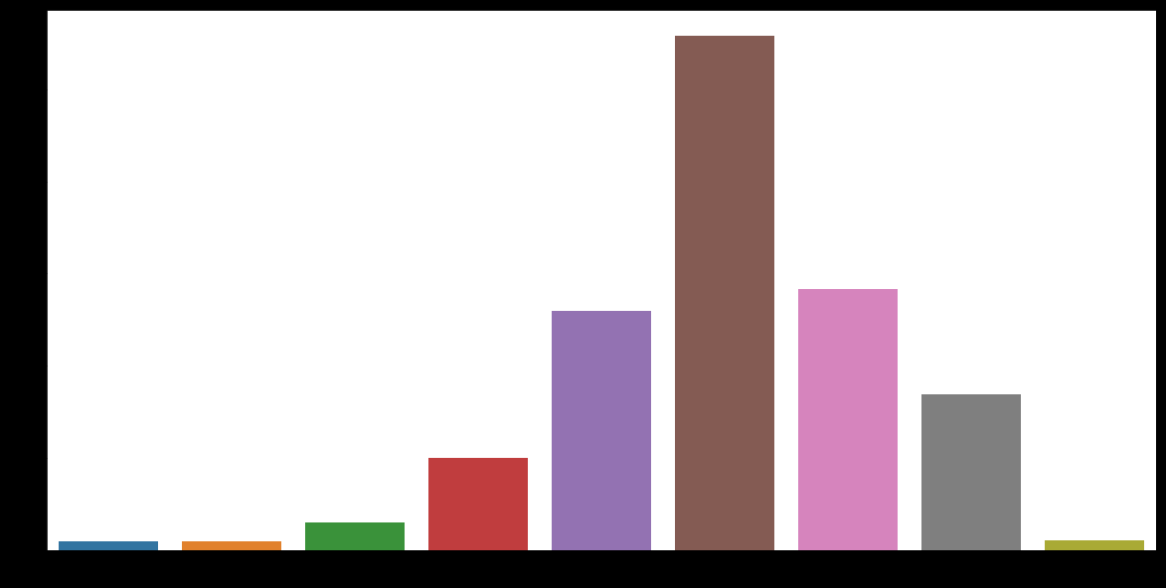
Movie Rating
6-7 rated movies in brown colour outlies the remaining
We can also see that data is right skewed

Slide 4
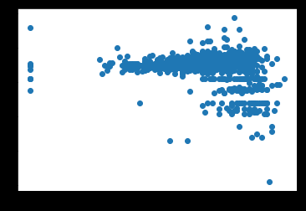

Rating Vs Runtime
From the above plot we can infer that rating and runtime are opposite to each other

Slide 5
Top 5 Movies
MovieName | Rating | Genre | Runtime | Stars
1281 | Wayward Sisters | 9.2 | Horror| Thriller | 60 | Stars:Kathryn Newton| Kim Rhodes| Clark Backo|...
83 | The Twilight Zone | 9.0 | Horror| Thriller | 51 | Stars:Rod Serling| Robert McCord| Jay Overholt...
0 | Stranger Things | 8.9 | Horror| Thriller | 51 | Stars:Millie Bobby Brown| Finn Wolfhard| Winon...
452 | Yakusoku no Neverland | 8.9 | Horror| Thriller | 30 | Stars:Sumire Morohoshi| Maaya Uchida| Mariya I...
441 | Over the Garden Wall | 8.9 | Horror| Thriller | 110 | Stars:Elijah Wood| Collin Dean| Melanie Lynske...

Slide 6

Wayward Sisters
Wayward Sisters
Supernatural episode (season 13, episode 10)
Description
When Sam and Dean go missing, Jody Mills calls on Claire Novak to help find the Winchesters; some women coalesce and head off on the most important hunt of their lives.
Show: Supernatural
Seasons: 13
Episodes: 10
Air date: 18 January 2018

Slide 7
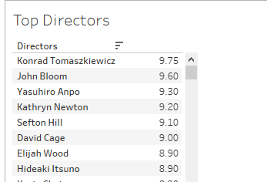
Based on Average Ratings of movies Mr Konrad topped the list of best Directors .

Slide 8

Konrad Tomaszkiewicz
CD PROJEKT RED’s Vice President of Game Development / Design Director - Cyberpunk 2077
Warsaw, Masovian District, Poland
Profile:(https://www.linkedin.com/in/konrad-tomaszkiewicz-1564084/)

Slide 9
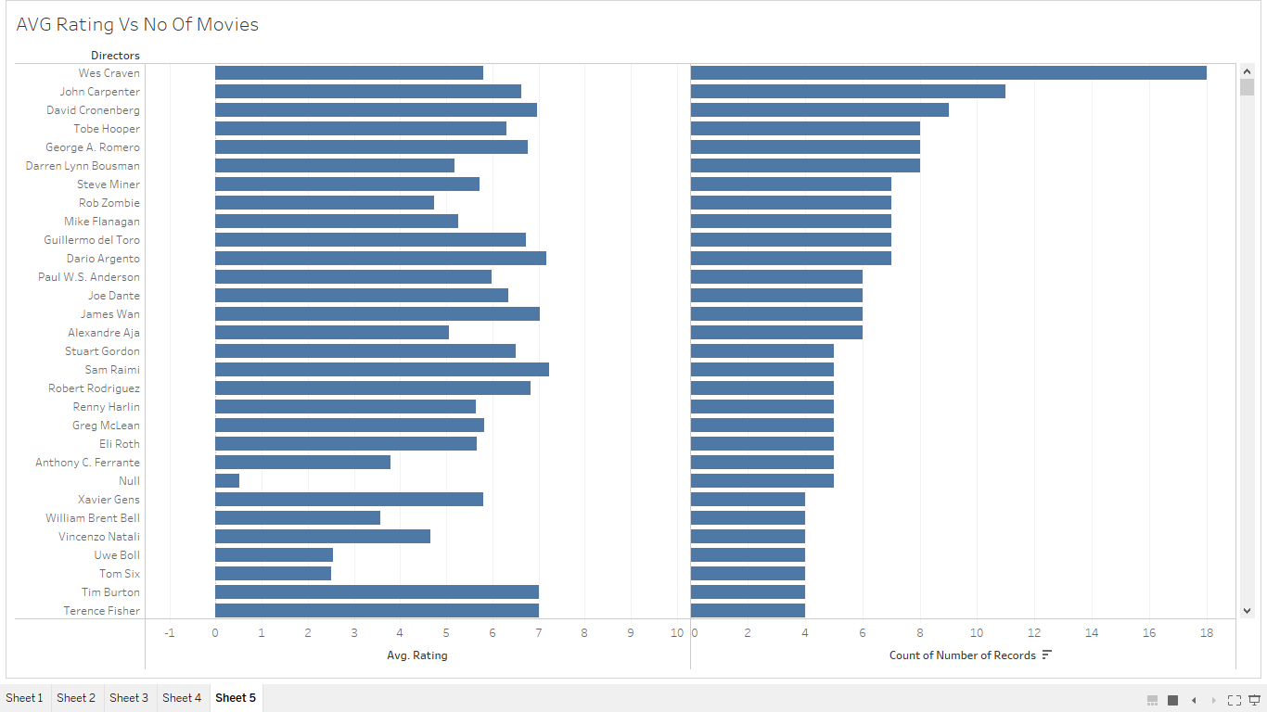
From the above plot we can say that the more number of movies the director directs the less(below or equal to 6.0) his/her rating is in maximum number of cases

Slide 10
THANK YOU ☺

